Slide 1
User interface design

Slide 2
User interface is the first impression of a software system from the user’s point of view. Therefore any software system must satisfy the requirement of user. UI mainly performs two functions −
Accepting the user’s input
Displaying the output

Slide 3
User interface is the front-end application view to which user interacts in order to use the software. The software becomes more popular if its user interface is:
Attractive
Simple to use
Responsive in short time
Clear to understand
Consistent on all interface screens

Slide 4
User interface plays a crucial role in any software system. It is possibly the only visible aspect of a software system as
Users will initially see the architecture of software system’s external user interface without considering its internal architecture.
A good user interface must attract the user to use the software system without mistakes. It should help the user to understand the software system easily without misleading information. A bad UI may cause market failure against the competition of software system

Slide 5
UI has its syntax and semantics. The syntax comprises component types such as textual, icon, button etc. and usability summarizes the semantics of UI. The quality of UI is characterized by its look and feel (syntax) and its usability (semantics).
There are basically two major kinds of user interface − a) Textual b) Graphical.

Slide 6
User Interface Golden rules
Strive for consistency - Consistent sequences of actions should be required in similar situations. Identical terminology should be used in prompts, menus, and help screens. Consistent commands should be employed throughout.
Enable frequent users to use short-cuts - The user’s desire to reduce the number of interactions increases with the frequency of use. Abbreviations, function keys, hidden commands, and macro facilities are very helpful to an expert user

Slide 7
Offer informative feedback - For every operator action, there should be some system feedback. For frequent and minor actions, the response must be modest, while for infrequent and major actions, the response must be more substantial.
Design dialog to yield closure - Sequences of actions should be organized into groups with a beginning, middle, and end. The informative feedback at the completion of a group of actions gives the operators the satisfaction of accomplishment and a sense of relief

Slide 8
Offer simple error handling - As much as possible, design the system so the user will not make a serious error. If an error is made, the system should be able to detect it and offer simple, comprehensible mechanisms for handling the error.
Permit easy reversal of actions - This feature relieves anxiety, since the user knows that errors can be undone. Easy reversal of actions encourages exploration of unfamiliar options. The units of reversibility may be a single action, a data entry, or a complete group of actions.

Slide 9
Support internal locus of control - Experienced operators strongly desire the sense that they are in charge of the system and that the system responds to their actions. Design the system to make users the initiators of actions rather than the responders.
Reduce short-term memory load - The limitation of human information processing in short-term memory requires the displays to be kept simple, multiple page displays be consolidated, window-motion frequency be reduced.

Slide 10
GOLDEN RULES
Place the user in control
Reduce users memory load
Make the interface consistant

Slide 11
User Interface Models
When a user interface is analyzed and designed following four models are used
User profile model
Design model
Implementation model
User's mental model

Slide 12
User profile model
Created by a user or software engineer, which establishes the profile of the end-users of the system based on age, gender, physical abilities, education, motivation, goals, and personality.
Design model
Created by a software engineer which incorporates data, architectural, interface, and procedural representations of the software.
Derived from the analysis model of the requirements and controlled by the information in the requirements specification which helps in defining the user of the system.

Slide 13
Implementation model
Created by the software implementers who work on look and feel of the interface combined with all supporting information (books, videos, help files) that describes system syntax and semantics.
Serves as a translation of the design model and attempts to agree with the user's mental model so that users then feel comfortable with the software and use it effectively.

Slide 14
User's mental model
Created by the user when interacting with the application. It contains the image of the system that users carry in their heads.
Often called the user's system perception and correctness of the description depends upon the user’s profile and overall familiarity with the software in the application domain.

Slide 15
User Interface Design Activities
There are a number of activities performed for designing user interface. The process of GUI design and implementation is alike SDLC. Any model can be used for GUI implementation among Waterfall, Iterative or Spiral Model
A model used for GUI design and development should fulfill these GUI specific steps.

Slide 16
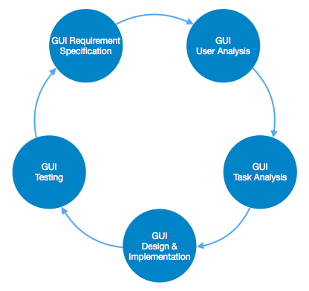

Slide 17
GUI Requirement Gathering - The designers may like to have list of all functional and non-functional requirements of GUI. This can be taken from user and their existing software solution.
User Analysis - The designer studies who is going to use the software GUI. The target audience matters as the design details change according to the knowledge and competency level of the user.

Slide 18
Task Analysis - Designers have to analyze what task is to be done by the software solution. Here in GUI, it does not matter how it will be done. Tasks can be represented in hierarchical manner taking one major task and dividing it further into smaller sub-tasks. Tasks provide goals for GUI presentation.

Slide 19
GUI Design & implementation - Designers after having information about requirements, tasks and user environment, design the GUI and implements into code and embed the GUI with working or dummy software in the background. It is then self-tested by the developers.

Slide 20
Testing - GUI testing can be done in various ways. Organization can have in-house inspection, direct involvement of users and release of beta version are few of them.

Slide 21
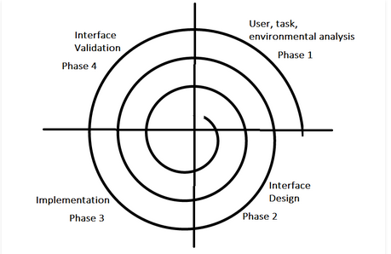
User Interface Design Process

Slide 22
The analysis and design process of a user interface is iterative and can be represented by a spiral model.
The analysis and design process of user interface consists of four framework activities.
User, task, environmental analysis, and modeling:
Interface Design:
Interface construction and implementation
Interface Validation

Slide 23
User, task, environmental analysis, and modeling:
Initially, the focus is based on the profile of users who will interact with the system, i.e. understanding, skill and knowledge, type of user, etc, based on the user’s profile users are made into categories. From each category requirements are gathered. Based on the requirements developer understand how to develop the interface.

Slide 24
Once all the requirements are gathered a detailed analysis is conducted.
In the analysis part, the tasks that the user performs to establish the goals of the system are identified, described and elaborated.

Slide 25
Interface Design: The goal of this phase is to define the set of interface objects and actions i.e. Control mechanisms that enable the user to perform desired tasks.
Indicate how these control mechanisms affect the system
Specify the action sequence of tasks and subtasks, also called a user scenario.
Indicate the state of the system when the user performs a particular task.
Always follow the golden rules stated by Theo Mandel. This phase serves as the foundation for the implementation phase.

Slide 26
Interface construction and implementation: The implementation activity begins with the creation of prototype (model) that enables usage scenarios to be evaluated. As iterative design process continues a User Interface toolkit that allows the creation of windows, menus, device interaction, error messages, commands, and many other elements of an interactive environment can be used for completing the construction of an interface.

Slide 27
Interface Validation: This phase focuses on testing the interface. The interface should be in such a way that it should be able to perform tasks correctly and it should be able to handle a variety of tasks. It should achieve all the user’s requirements. It should be easy to use and easy to learn. Users should accept the interface as a useful one in their work.

Slide 28
Coding
The coding is the process of transforming the design of a system into a computer language format.
This coding phase of software development is concerned with software translating design specification into the source code
Coding is done by the coder or programmers who are independent people than the designer.
The goal is not to reduce the effort and cost of the coding phase, but to cut to the cost of a later stage. The cost of testing and maintenance can be significantly reduced with efficient coding.

Slide 29
Goals of Coding
To translate the design of system into a computer language format: The coding is the process of transforming the design of a system into a computer language format, which can be executed by a computer and that perform tasks as specified by the design of operation during the design phase.

Slide 30
To reduce the cost of later phases: The cost of testing and maintenance can be significantly reduced with efficient coding.
Making the program more readable: Program should be easy to read and understand. It increases code understanding and readability

Slide 31
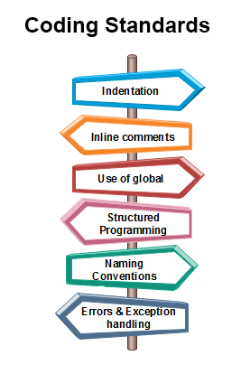

Slide 32
Coding Guidelines
General coding guidelines provide the programmer with a set of the best methods which can be used to make programs more comfortable to read and maintain. Most of the examples use the C language syntax, but the guidelines can be tested to all languages.

Slide 33
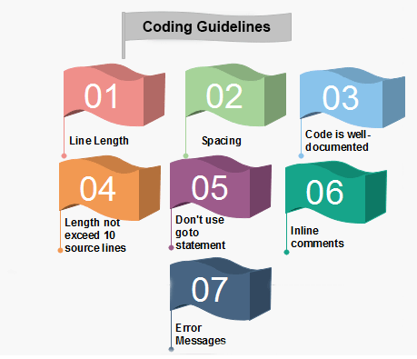

Slide 34
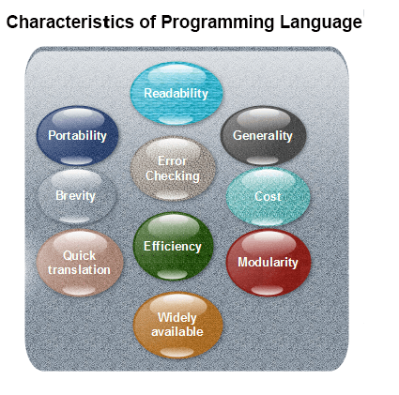

Slide 35
Readability: A good high-level language will allow programs to be written in some methods that resemble a quite-English description of the underlying functions.
Portability: High-level languages, being virtually machine-independent, should be easy to develop portable software.

Slide 36
Generality: Most high-level languages allow the writing of a vast collection of programs, thus relieving the programmer of the need to develop into an expert in many diverse languages
Brevity: Language should have the ability to implement the algorithm with less amount of code
Error checking: A programmer is likely to make many errors in the development of a computer program. Many high-level languages invoke a lot of bugs checking both at compile-time and run-time.

Slide 37
Cost: The ultimate cost of a programming language is a task of many of its characteristics.
Quick translation: It should permit quick translation.
Efficiency: It should authorize the creation of an efficient object code.
Modularity: It is desirable that programs can be developed in the language as several separately compiled modules.

Slide 38
Widely available: Language should be widely available, and it should be feasible to provide translators for all the major machines and all the primary operating systems

